Slide 1

Eyes on the prize Thaler, Schütz, Goodale & Gegenfutner, 2013

Slide 2
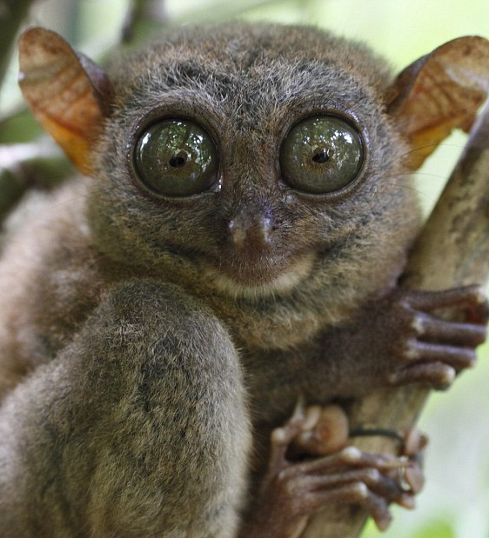
Noisy eyes
Causes problems in:
Neuroimaging
EEG, MEG and fMRI
Electroretinography
Eye tracking
Lesser extent behavioural studies

Slide 3

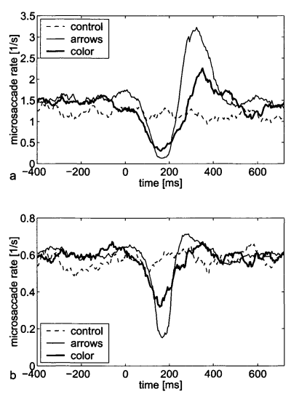
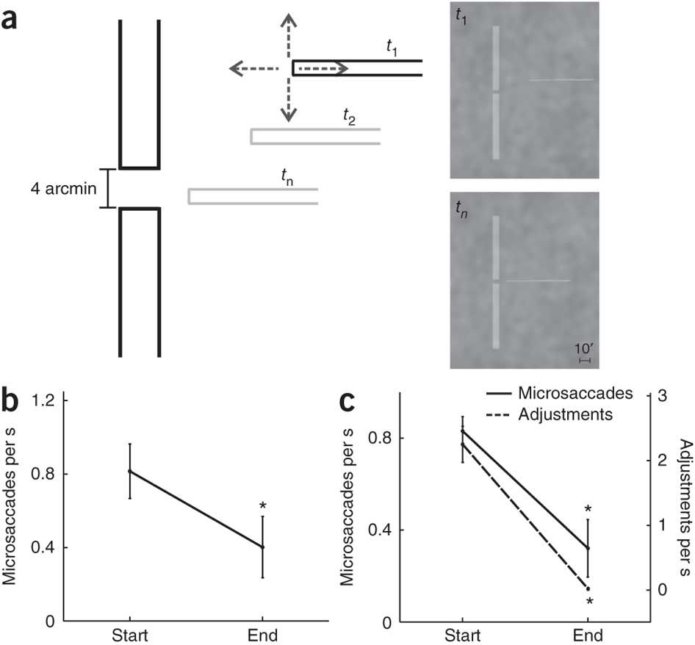
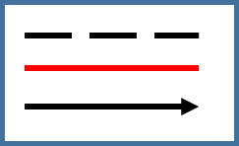
Properties of fixation
What doesn’t work:
Blur, colour, luminance and contrast have no effect. (Boyce, 1967; Steinman, 1965; Ukwade & Bedell, 1993)
What alters fixation:
Selective attention to parts of the display
Precision (if task appropriate)
Visual distractors
Size (microsaccade rate and drift)
Ko, Poletti & Rucci, 2010
Engbert & Kliegl, 2003a

Slide 4

What about shape?
Good question Mighty Boi!

Slide 5



But what about the shape?
Literature Search in Journal of Vision with term ‘fixa’ No ‘gold standard’ was found, however, fun designs were…

Slide 6
Experiment 1 – Fixation Shapes Experiment 2 was the same, except the outer circle and cross subtended 0.6° visual angle. Results were the same across experiments.
A
B
C
0.2°
1.5°
AB
AC
BC
ABC

Slide 7
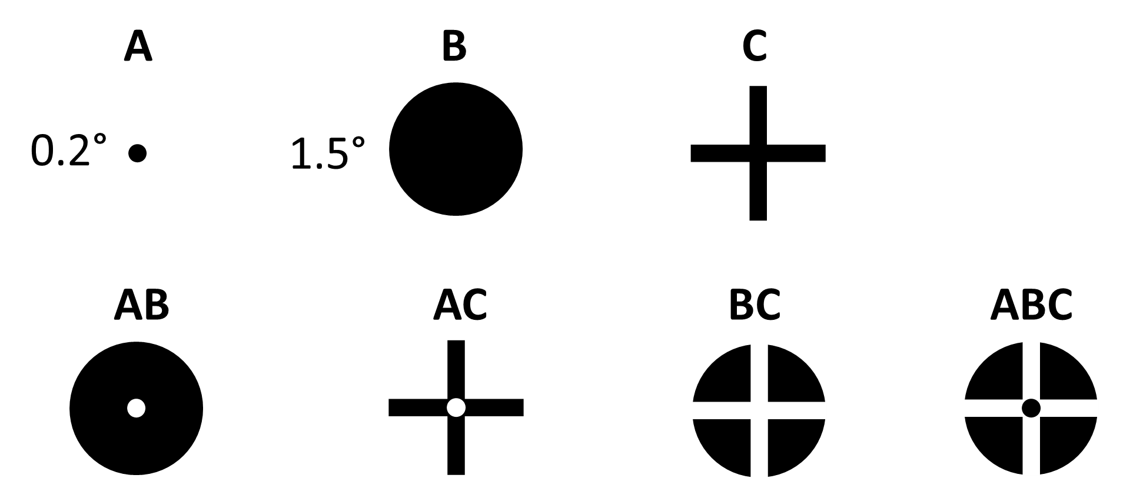
Procedure
- 12 participants
Black and white stimuli on grey background
Asked to fixate on the stimuli for 17s
4 sessions of 63 trials = 152 trials
Self initiate a trial
10s Black Stim
7s White Stim
3s Grey Screen

Slide 8
Analysis
Removed data 200 ms pre- and 500 ms post-blink.
Microsaccade
Moving average of velocities over five 12 ms windows
True microsaccade when the path length divided Euclidian distance from start-to-finish ≥ 0.5
Dispersion of microsaccades in 2D plane (2DSD) measured by the area of a minimum variance ellipse, fitted on each trial.

Slide 9
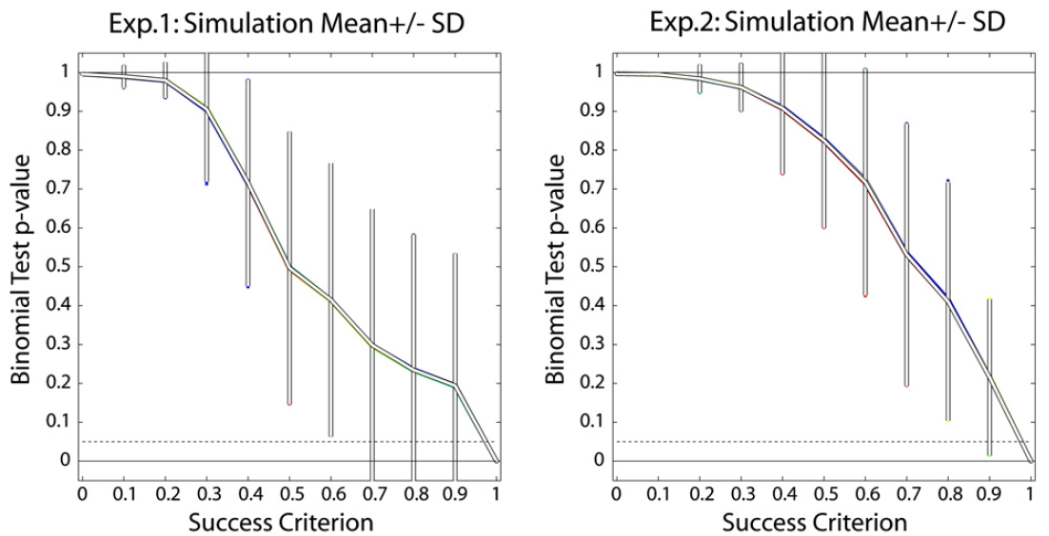
Results
Notes:
The numerical value of the success criterion will affect the number of successes. For example, if the success criterion is zero, only data points that have the minimum dispersion and microsaccade values will be considered successful, which would make success very unlikely. Conversely, if the criterion is one, all data points will be considered successful, which would make success certain. Thus, the success criterion will affect the probability of retaining the Null hypothesis (p-value) in the context of our analysis. Specifically, we would expect that the probability of retaining the Null hypothesis decreases as the success criterion increases from zero to one, so that p-values might be biased towards falsely rejecting the Null hypothesis.

Slide 10
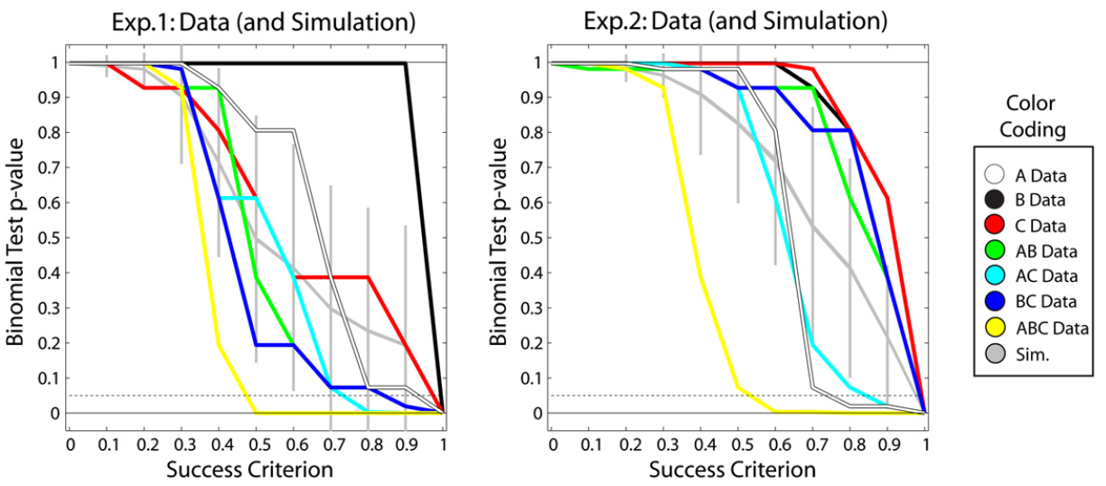
Results
Notes:
The numerical value of the success criterion will affect the number of successes. For example, if the success criterion is zero, only data points that have the minimum dispersion and microsaccade values will be considered successful, which would make success very unlikely. Conversely, if the criterion is one, all data points will be considered successful, which would make success certain. Thus, the success criterion will affect the probability of retaining the Null hypothesis (p-value) in the context of our analysis. Specifically, we would expect that the probability of retaining the Null hypothesis decreases as the success criterion increases from zero to one, so that p-values might be biased towards falsely rejecting the Null hypothesis.

Slide 11
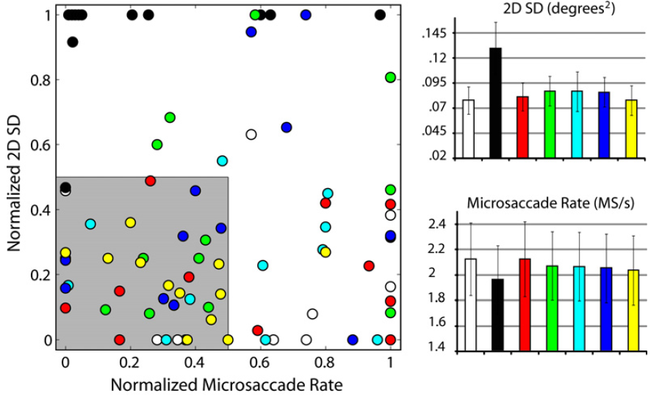
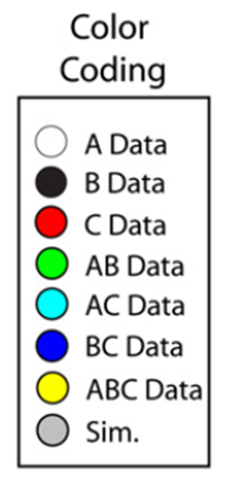
Results
Notes:
The numerical value of the success criterion will affect the number of successes. For example, if the success criterion is zero, only data points that have the minimum dispersion and microsaccade values will be considered successful, which would make success very unlikely. Conversely, if the criterion is one, all data points will be considered successful, which would make success certain. Thus, the success criterion will affect the probability of retaining the Null hypothesis (p-value) in the context of our analysis. Specifically, we would expect that the probability of retaining the Null hypothesis decreases as the success criterion increases from zero to one, so that p-values might be biased towards falsely rejecting the Null hypothesis.

Slide 12
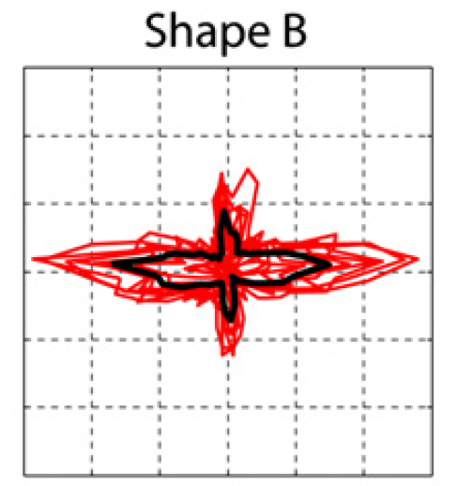
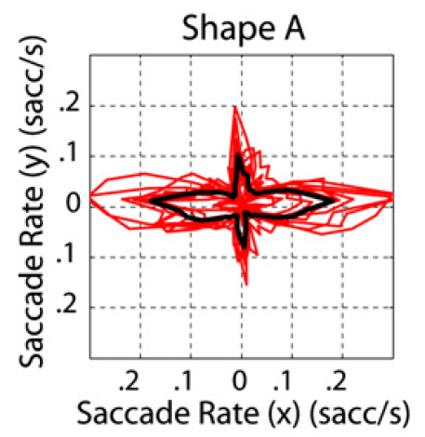
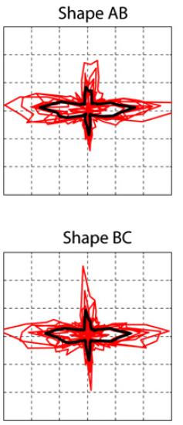
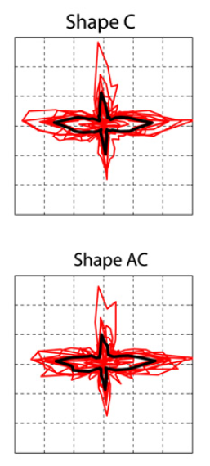
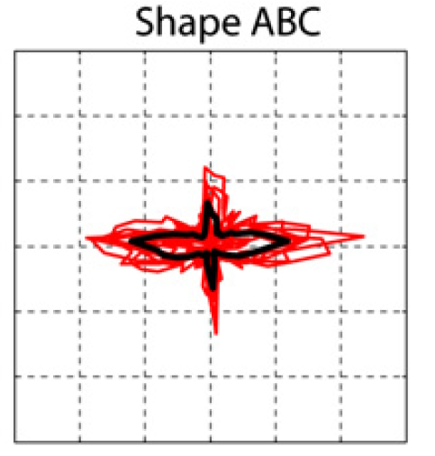
Results
Red lines – Individual
Black lines – Average
Notes:
The numerical value of the success criterion will affect the number of successes. For example, if the success criterion is zero, only data points that have the minimum dispersion and microsaccade values will be considered successful, which would make success very unlikely. Conversely, if the criterion is one, all data points will be considered successful, which would make success certain. Thus, the success criterion will affect the probability of retaining the Null hypothesis (p-value) in the context of our analysis. Specifically, we would expect that the probability of retaining the Null hypothesis decreases as the success criterion increases from zero to one, so that p-values might be biased towards falsely rejecting the Null hypothesis.

Slide 13

Discussion
Most saccades were horizontally aligned (ergo not just ‘noise’ else this would be isotropic)
Saccade amplitudes were in excess of measurement noise
In the absence of a target, microsaccade rate decreases; however, this absence reduces the accuracy of fixation and increases dispersion (Cherici et al., 2012)
Smaller fixation stimuli decrease the rate of dispersion
ABC was the best shape to keep participant’s eyes on the prize

